Slide 1


LFY 2027 Federal Housing & Community Development Grants Application Training
Friday, October 24, 2025

Slide 2
AGENDA
Welcome and Introductions
Background on ACDS
Grant Eligibility and County Priorities
Application Process
Grant Requirements- once funds have been awarded

Slide 3
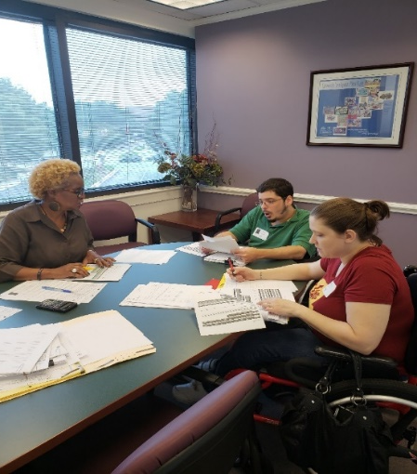
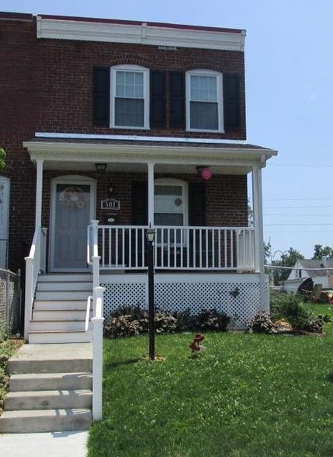
Arundel Community Development Services, Inc.
Nonprofit housing & community development agency established in 1993
Housing rehabilitation, affordable rental development, housing counseling, financial empowerment, accessibility modifications, public facilities, and energy & weatherization improvements
Experienced grant administrator & manager of capital projects

Slide 4
Federal Housing & Community Development Grants
Consolidated Plan Programs
  Community Development Block Grant (CDBG)
  HOME Investment Partnership Program (HOME)
  Emergency Solutions Grant Program (ESG)
  Housing Opportunities for Persons with AIDS (HOPWA)
FY27 Potentially Available Funds
  CDBG = $2,818,569 (15% cap for Public Service = $422,785)
  HOME = $1,518,900
  ESG = $184,231
  HOPWA = $527,755
FY26 Public Service awards can be found HERE

Slide 5
FY2026 – FY2030 Consolidated Plan
First Public Hearing of the
FY2026 – FY2030 Consolidated Plan Process
Thursday, October 23rd, 2025
5:30 – 7:30 p.m.
ACDS Conference Room; 2226 Riva Road, Annapolis
Report on FY2025 Accomplishments
Gather input on housing and community development needs
FY2027 budget process is the second year of County’s new five-year Consolidated Plan
FY2026 – FY2030 Consolidated Plan’s strategies and goals allowed for eligible activities serving low-to-moderate income households in the areas of:
    Homeownership Opportunities
    Rental Housing Opportunities
    Preventing and Ending Homelessness
    Sustainable Communities
    Promoting Fair Housing

Slide 6
Eligible Grant Applicants
Nonprofit Organization - with 501 c 3 status
Good standing with MD SDAT
Provide a direct service to A.A. County residents
Have an established Board of Directors
Have filed IRS form 990 and/or audited financials from most recent fiscal year
Meet ACDS insurance requirements
Able to comply with all terms, conditions, and certifications of the required grant agreement
Meet Faith-Based Guidelines
Completes Risk Assessment Questionnaire

Slide 7
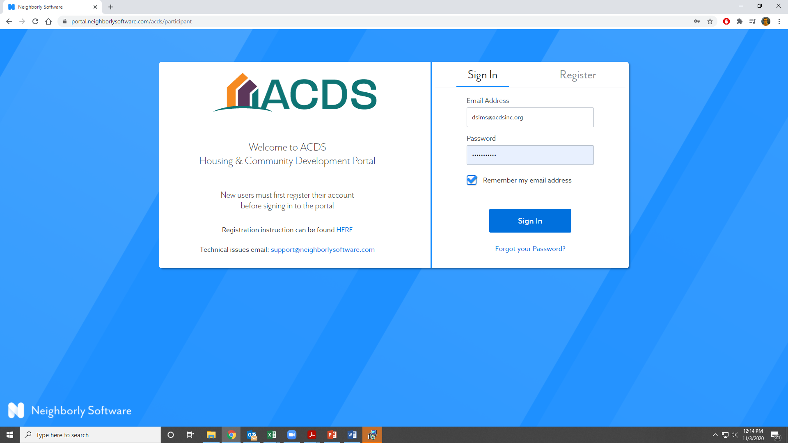
Application Process
All applications will be submitted through ACDS’s Neighborly Portal. https://portal.neighborlysoftware.com/acds/participant
We strongly recommend that you use Google Chrome to complete the application.

Slide 8
Review Process
Applications will be judged based on, but not limited to, the following criteria;
Relevance to Consolidated Plan strategies and goals
Demonstrated need for the program
Quality of proposed outcome measures
Completeness/clarity of application
History of compliance with grant requirements
Organizational stability
Demonstration of sound financial planning

Slide 9
Grant Timeline
Wednesday, October 22, 2025
Federal Housing and Community Development Application available through Neighborly
Thursday, October 23, 2025
Public Hearing on FY25 Accomplishments and Gather input on housing and community development needs
Wednesday, December 10, 2025
Applications due at 12:00 p.m.
March 2026
Recommendations made to County Executive
June 2026
FY 2027 Budget approved by County Council
Tuesday, July 1, 2026
Fiscal Year 2027 begins
Grantees meet final grant award requirements and execute award agreements
Grantees should not expend funding until agreements are executed by both parties and they speak to their ACDS grant manager.

Slide 10
GRANT
REQUIREMENTS

Slide 11
Going Under Agreement
Required documents
  Insurance certificate
    Comprehensive General Liability: $2 million general aggregate, $1 million per occurrence
    Auto - $1 million combined single limit
    Workers’ Comp
    Note: You may request a waiver for Auto, Workers’ Comp, as applicable
  Updated budget
  Authorized signatory confirmation
  Signed, executed agreement

Slide 12
Invoicing
IMPORTANT: Do Not Start Spending money until you are under contract and you have talked to your grant rep about how to invoice
All invoicing will be completed in your Neighborly portal
Awards are paid out on a reimbursement basis
ACDS strives to make payment within 30 days of receipt of a complete invoice
  Signed Cover letter
  Summary of expenses
  Documentation of expenses (receipts, timesheets, payroll, etc.)

Slide 13
Reporting
Please communicate regularly with your grant manager!
Operating Grants
  Bi-annual Reports in Neighborly
  Financial Review – Independent review of the organization finances as a whole
  Monitoring – contact your grant manager to schedule a monitoring visit during program implementation
  Pictures!

Slide 14
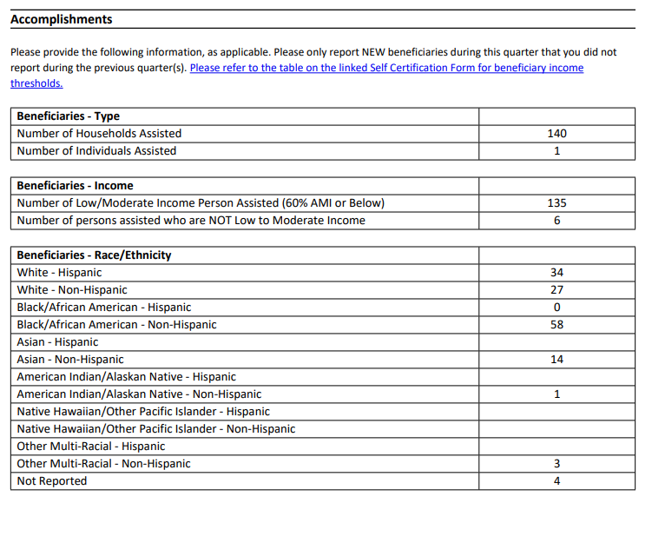

Slide 15
QUESTIONS?

Slide 16
Tracey Mullery
Grant Manager tmullery@acdsinc.org / (410) 222-3961
Bobbie Sullivan
Grant Associate bsullivan@acdsinc.org / (410) 222-3964
Elisha Harig-Blaine
Assistant Planning Director eharig-blaine@acdsinc.org / (410) 222-3236

