Slide 1

FY 2027 Community Grants Training
Friday, November 7, 2025

Slide 2
AGENDA
Welcome and Introductions
LRCIF Grant Eligibility and Strategic Priorities
Application Process
Grant Requirements- once funds have been awarded

Slide 3
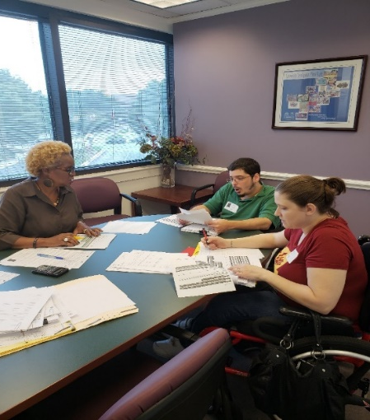
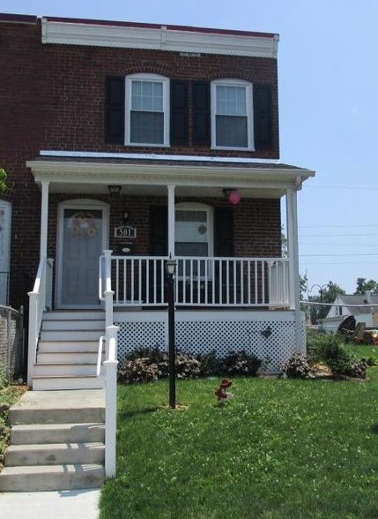
Arundel Community Development Services, Inc.
Nonprofit housing & community development agency established in 1993
Housing rehabilitation, affordable rental development, housing counseling, financial empowerment, accessibility modifications, public facilities, and energy & weatherization improvements
Experienced grant administrator & manager of capital projects

Slide 4
LRCIF Community Grants
Laurel Race Course Impact Fund (LRCIF) Grants are funded through fees and taxes generated from the operation of the Laurel Race Course.
The amount available varies each year depending on revenues. Last year, the LRCIF awarded $455,000 in Grants.
Awards are typically for between $10,000 and $50,000, and requests should be for a minimum of $10,000

Slide 5
Eligible Grant Applicants
Applicant organization must have must have 501(c)(3) or 501(c)(4) status (Nonprofit)
AND
Located in Anne Arundel County within 3 miles of the Laurel Race Course.
Applications from organizations outside the three-mile radius will be considered if they demonstrate significant impacts for those who live and work within the three-mile area.

Slide 6
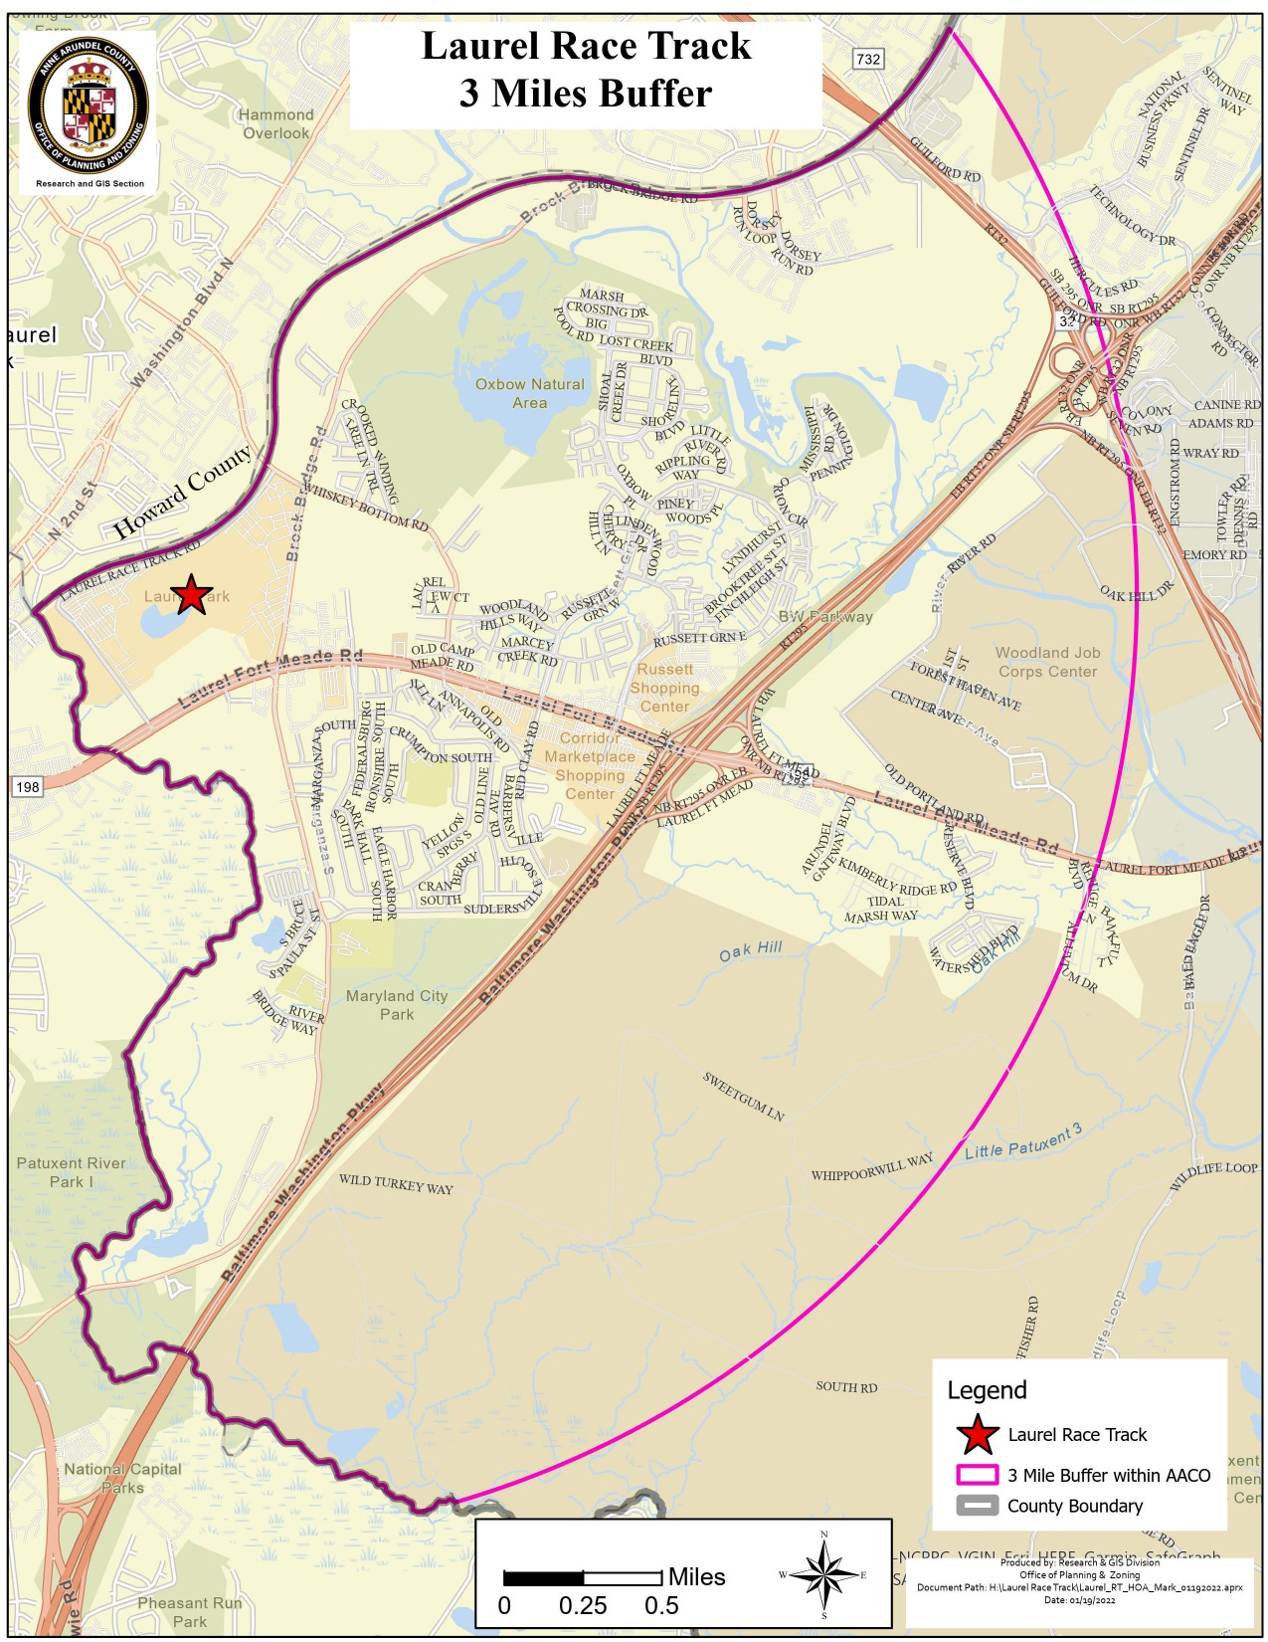

Slide 7
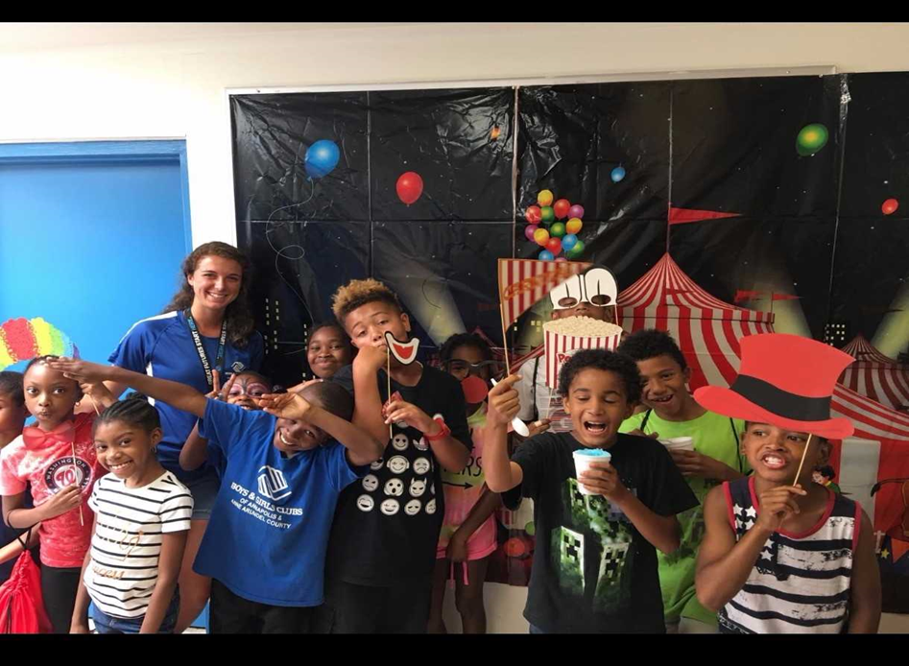
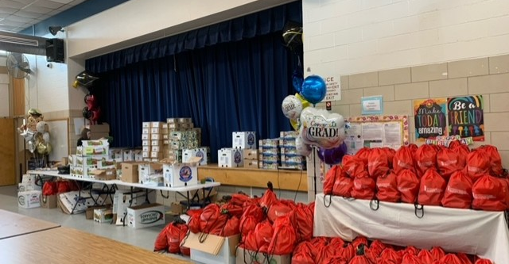
Eligible Activities
Grant funding can be used to purchase equipment, related supplies, or to make small capital improvements such as renovation, remodeling, or restoration/beautification of buildings or public community spaces for organizations located within the three-mile radius in Anne Arundel County.
Funding can be used to expand existing services or pilot test new programs

Slide 8
Application Review Criteria
Funding decisions are made based on, but not limited to, the following criteria:
Program/project is responsive to specific problems or needs of communities in Anne Arundel County within three miles of the Laurel Race Course. Organizations that provide services beyond the three-mile radius MUST demonstrate how funds will be used in the target communities.
Demonstrated need for the program/project.
Organizational capacity and previous grant management experience.
Community support for the project.
Completeness and clarity of grant application form.

Slide 9
LRCIF Grant Timeline – Part 1
FY 2027 LRCIF Grant Application is available now on our Neighborly Portal
Wednesday, December 17, 2025
Grant Applications due to ACDS
February 2025
Advisory Committee reviews applications and invites selected Grant applicants to make a presentation at the March Committee meetings
(Wednesday, March 4 & Wednesday, March 11 @ 6:30 pm, virtual)
March 2025
Selected applicants will present at March Meetings. LRCIF Advisory Committee makes final Grant Award Recommendations to County Executive

Slide 10
LRCIF Grant Timeline- Part 2
FY 2027 LRCIF Grant Application is available now in our Neighborly Portal
June 2026
FY 2027 Budget approved by County Council and applicants notified of award decisions.
Summer 2026
Grantees meet final grant award requirements and execute award agreements
FY 2027 awards will be for grant terms of July 1, 2026 – June 30, 2027.
Grantees should not expend funding until agreements are executed by both parties and they speak to their ACDS grant manager.

Slide 11
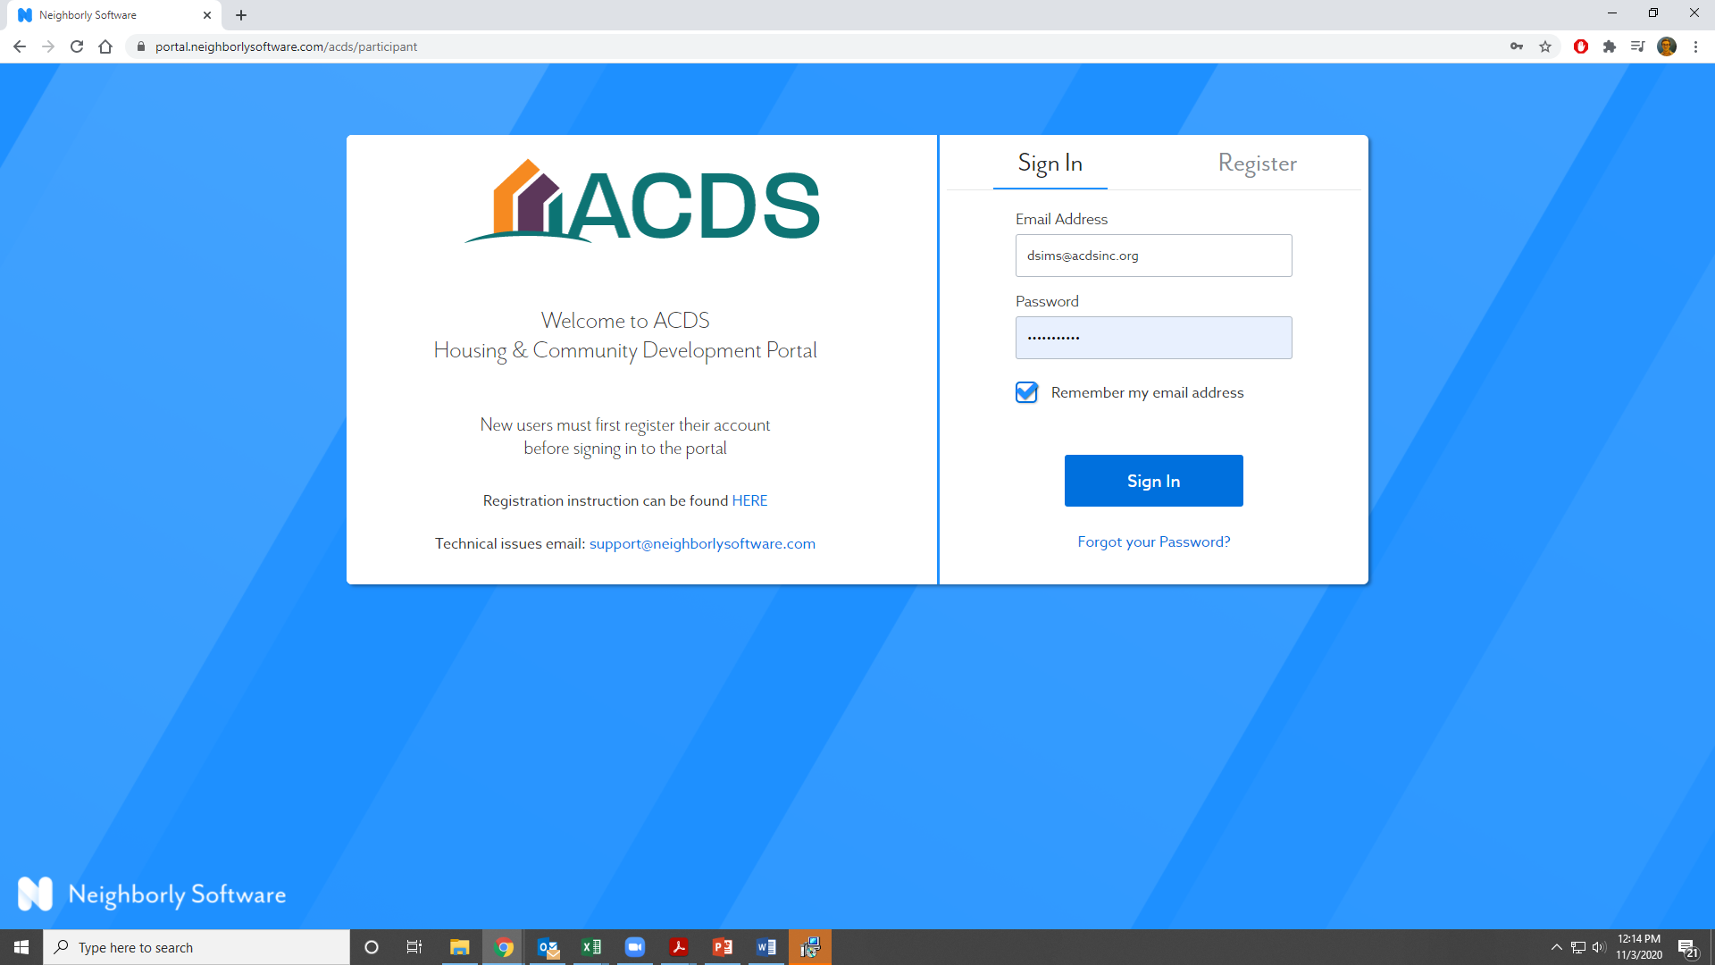
Application Process
This year, all applications will be submitted through ACDS’s Neighborly Portal. https://portal.neighborlysoftware.com/acds/participant

Slide 12
GRANT
REQUIREMENTS

Slide 13
Going Under Agreement
Required documents
  Current Insurance certificate
    Comprehensive General Liability: $2 million general aggregate, $1 million per occurrence
    Auto - $1 million combined single limit
    Workers’ Comp
    Note: You may request a waiver for Auto, Workers’ Comp, as applicable
  Updated budget
  Direct deposit forms
  Authorized signatory confirmation
  Signed, executed agreement

Slide 14
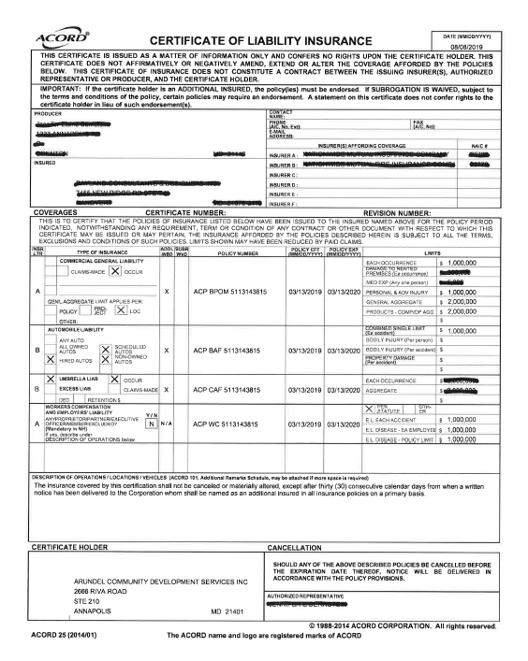
Insurance Requirements

Slide 15
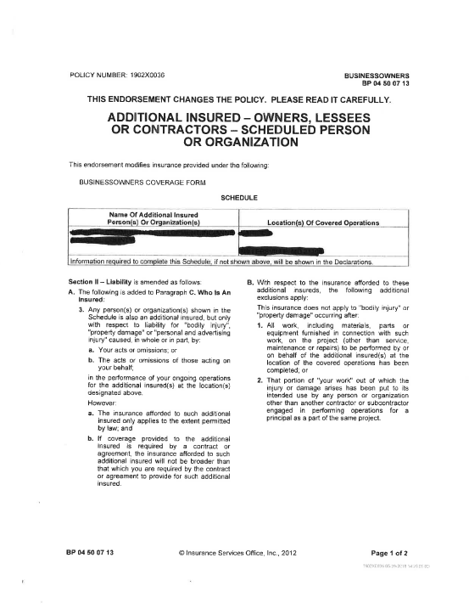
Capital Project Additional Insured

Slide 16
Invoicing
IMPORTANT: Do Not Start Spending funds until you are under contract and you have talked to your grant administrator about how to invoice
All invoicing will be completed in your Neighborly portal
Awards are paid out on a reimbursement basis (except some Capital projects)
ACDS strives to make payment within 30 days of receipt of a complete invoice
  Signed Cover letter
  Summary of expenses
  Documentation of expenses (receipts, timesheets, payroll, etc.)

Slide 17
Reporting
Program/Project Grants
  Biannual reporting – One at the mid-year mark and one at the end of year. Each report should give unduplicated data, as the reports aggregate this information for a total number served.
  Financial Review – Independent review of the organization finances as a whole
  Monitoring – contact Tracey Mullery, tmullery@acdsinc.org, to schedule a monitoring visit during program implementation
  Pictures!
Capital Grants
  Capital Grants – site inspection
  Final Report
  Pictures!

Slide 18
QUESTIONS
Tracey Mullery, Grant Manager
tmullery@acdsinc.org
(410) 222-3961
Elisha Harig-Blaine, Assistant Planning Director
eharig-blaine@acdsinc.org
(410) 222-3236

