Slide 1

FY 2027 Community Grants Training
Friday, October 17, 2025

Slide 2
AGENDA
Welcome and Introductions
LDC Grant Eligibility and Strategic Priorities
Application Process
Grant Requirements - once funds have been awarded

Slide 3
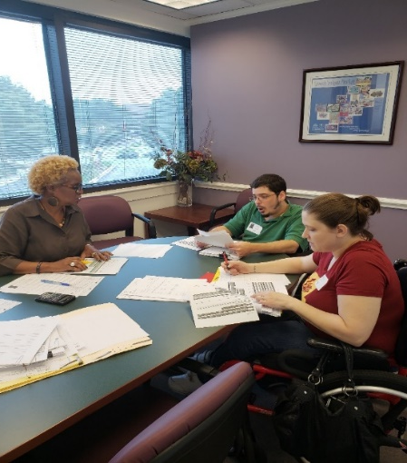
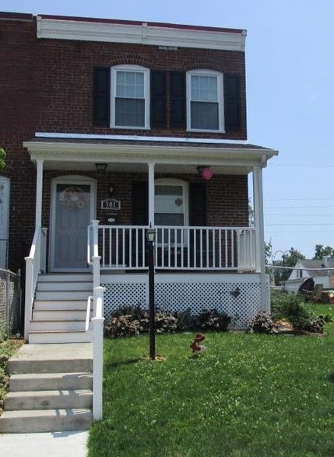
Arundel Community Development Services, Inc.
Nonprofit housing & community development agency established in 1993
Housing rehabilitation, affordable rental development, housing counseling, financial empowerment, accessibility modifications, public facilities, and energy & weatherization improvements
Experienced grant administrator & manager of capital projects

Slide 4
LDC Community Grants
Local Development Council (LDC) Community Grants are funded through casino revenues.
The amount available varies each year depending on revenues. Last year, the LDC awarded $400,000 in Community Grants.

Slide 5
Eligible Grant Applicants
Community Association - file either a Form 990 or 1120 tax return; or
Nonprofit Organization – must have 501(c)3 or
501(c)4 status
AND
Located in Anne Arundel County within 3 miles of the Live! Casino. Applications from organizations outside the three-mile radius will be considered if they demonstrate significant impacts for residents of the target area.

Slide 6
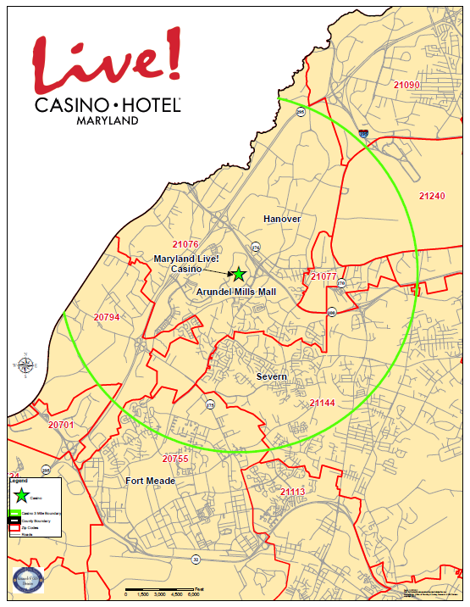

Slide 7
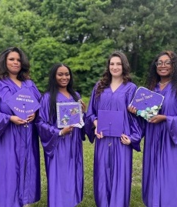
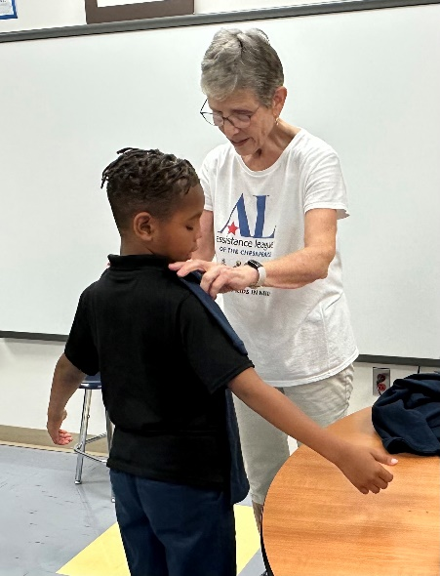
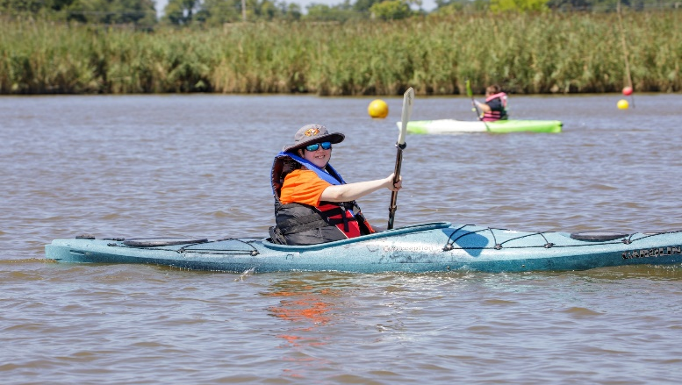
LDC Strategic Priorities
Providing Human Services for Success
Beautifying and Revitalizing Communities
Enhancing Educational Outcomes

Slide 8
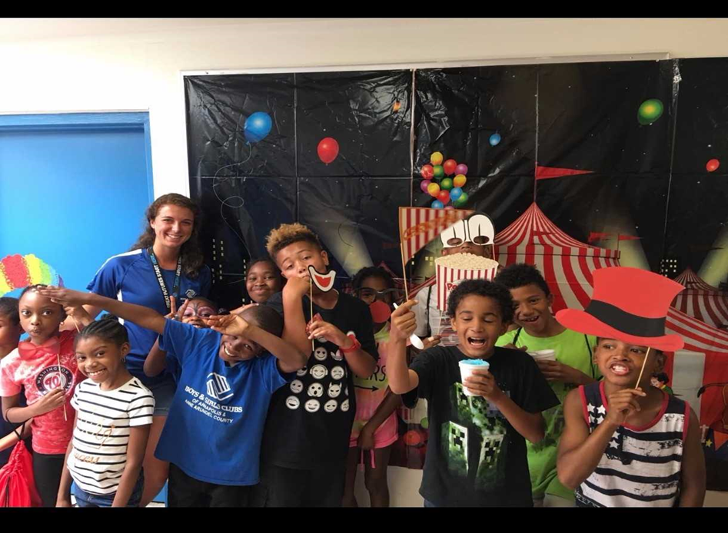
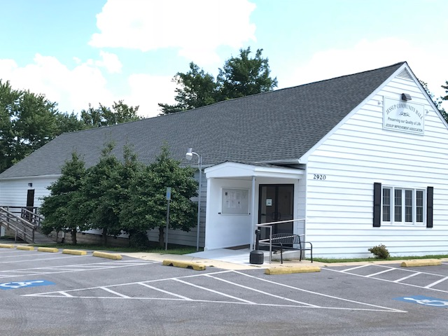
Eligible Activities
Capital Projects, including construction, landscaping, playground and signage installation, and housing rehabilitation.
Operating Programs, including staff costs, overhead and equipment purchases.

Slide 9
LDC Grant Timeline
FY 2027 LDC Grant Applications are available now on our Neighborly Portal
Wednesday, December 3, 2025
Community Grant Applications due to ACDS
February - April 2026
LDC Grant Committee reviews applications and invites selected Community Grant applicants to make presentations at the February, March and April LDC meetings
May 2026
LDC makes final Community Grant award Recommendations to County Executive
June 2026
FY 2027 Budget approved by County Council
Summer 2026
Grantees meet final grant award requirements and execute award agreements
FY2027 awards will be for grant terms of July 1, 2026 – June 30, 2027.
Grantees should not expend funding until agreements are executed by both parties and they speak to their ACDS grant manager.

Slide 10
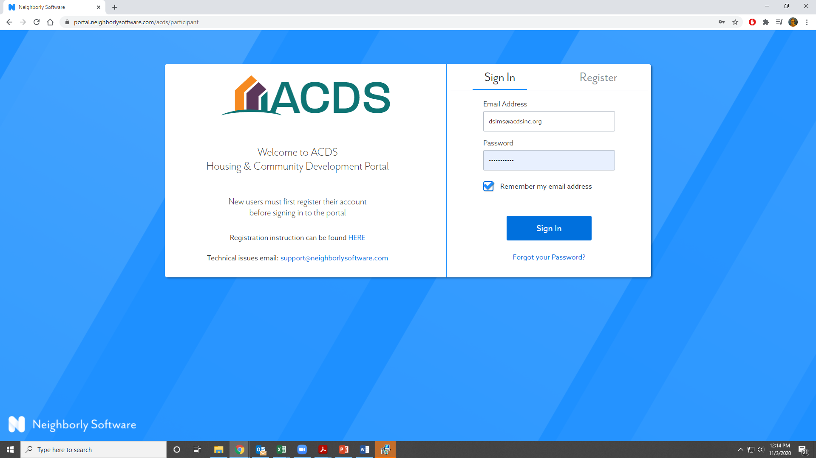
Application Process
This year, all applications will be submitted through ACDS’s Neighborly Portal. https://portal.neighborlysoftware.com/acds/participant

Slide 11
GRANT
REQUIREMENTS

Slide 12
Going Under Agreement
Required documents
  Current Insurance certificate
    Comprehensive General Liability: $2 million general aggregate, $1 million per occurrence
    Auto - $1 million combined single limit
    Workers’ Comp
    Note: You may request a waiver for Auto, Workers’ Comp, as applicable
  Updated budget
  Direct deposit forms
  Authorized signatory confirmation
  Signed, executed agreement

Slide 13
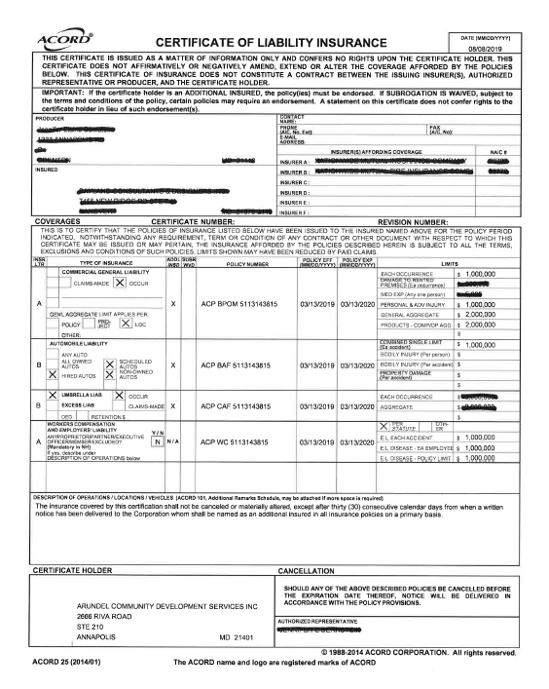
Insurance Requirements

Slide 14
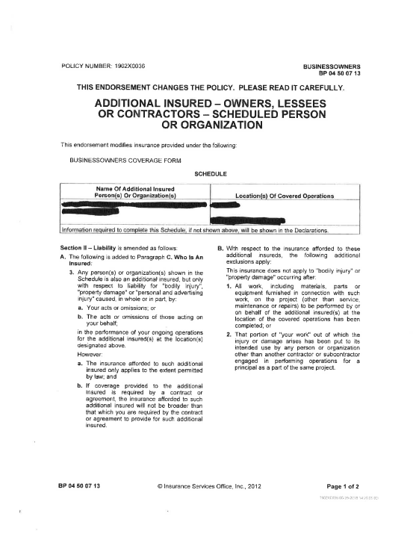
Capital Project Additional Insured

Slide 15
Invoicing
IMPORTANT: Do Not Start Spending money until you are under contract and you have talked to your grant rep about how to invoice
All invoicing will be completed in your Neighborly portal
Awards are paid out on a reimbursement basis (except some Capital projects)
ACDS strives to make payment within 30 days of receipt of a complete invoice
  Signed Cover letter
  Summary of expenses
  Documentation of expenses (receipts, timesheets, payroll, etc.)

Slide 16
Reporting
Operating Grants
  Biannual reporting – One at the mid-year mark and one at the end of year. Each report should give unduplicated data, as the reports aggregate this information for a total number served.
  Financial Review – Independent review of the organization finances as a whole
  Monitoring – contact Tracey Mullery, tmullery@acdsinc.org, to schedule a monitoring visit during program implementation
  Pictures!
Capital Grants
  Capital Grants – site inspection
  Final Report
  Pictures!

Slide 17
QUESTIONS
Public Service
Tracey Mullery, tmullery@acdsinc.org
Elisha Harig-Blaine, eharig-blaine@acdsinc.org
Capital Projects
Shawn Rice, srice@acdsinc.org

