Slide 1
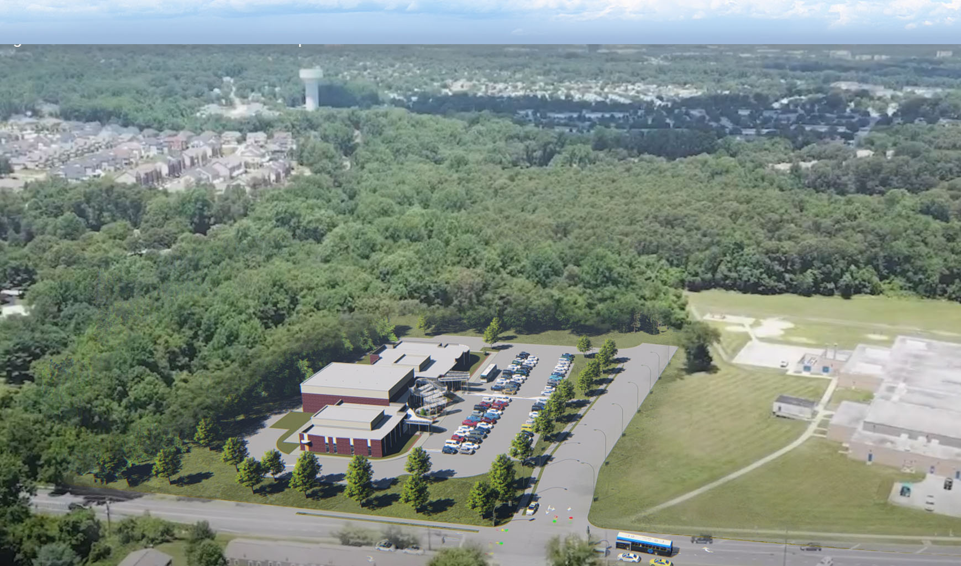
PROJECT SITE - AFTER
VAN BOKKELEN
ELEMENTARY
REECE RD.

Slide 2
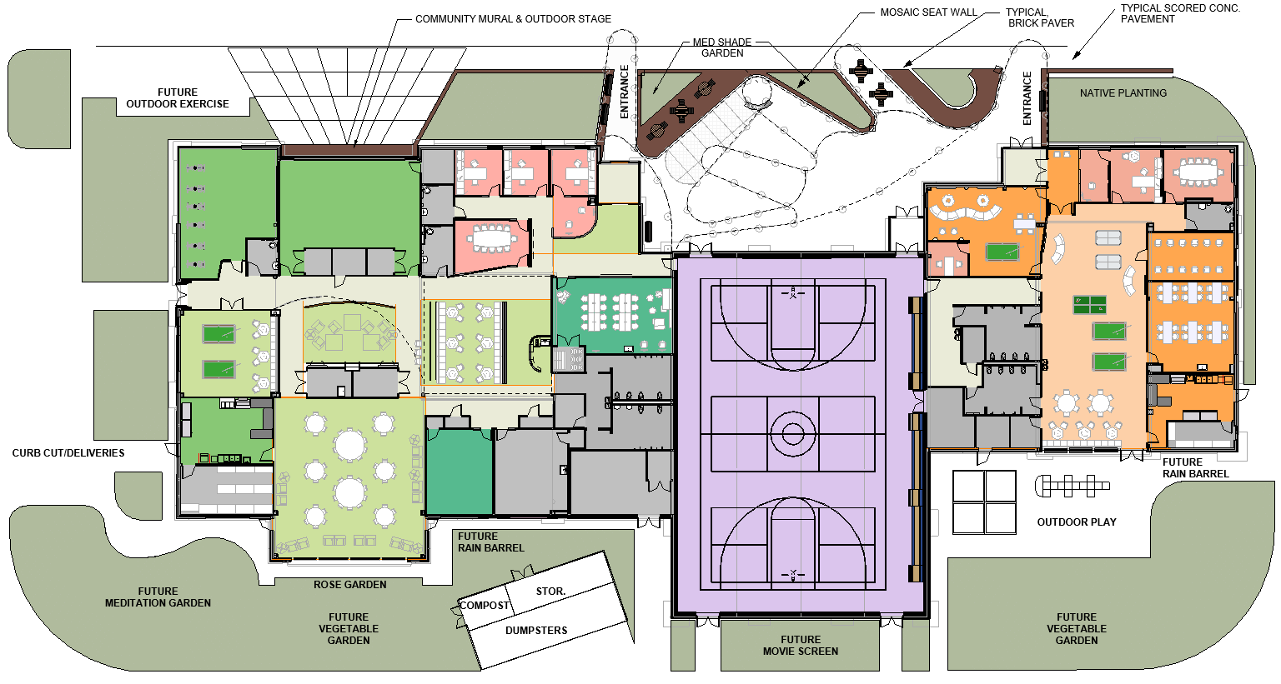
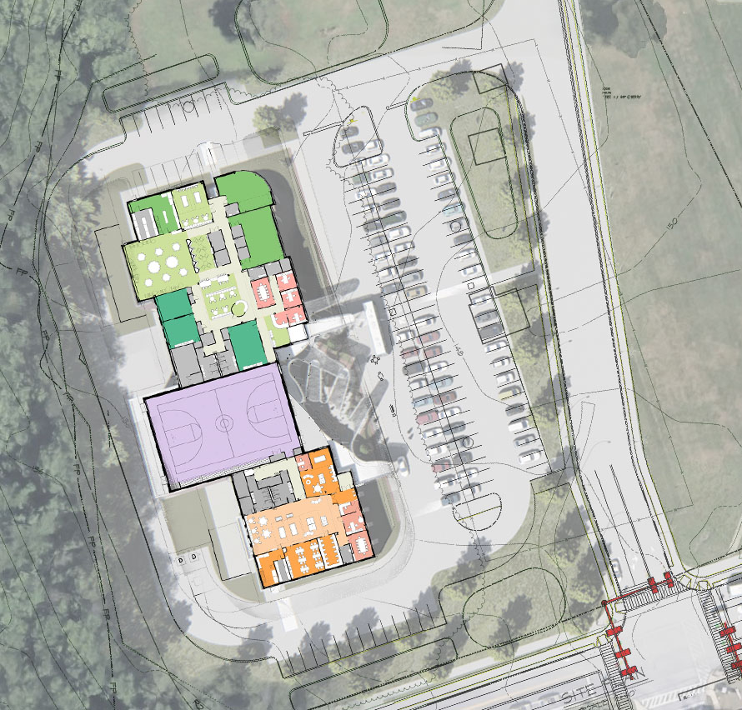
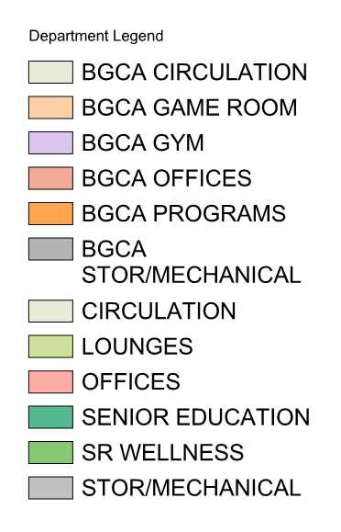
OVERALL PROGRAM PLAN

Slide 3
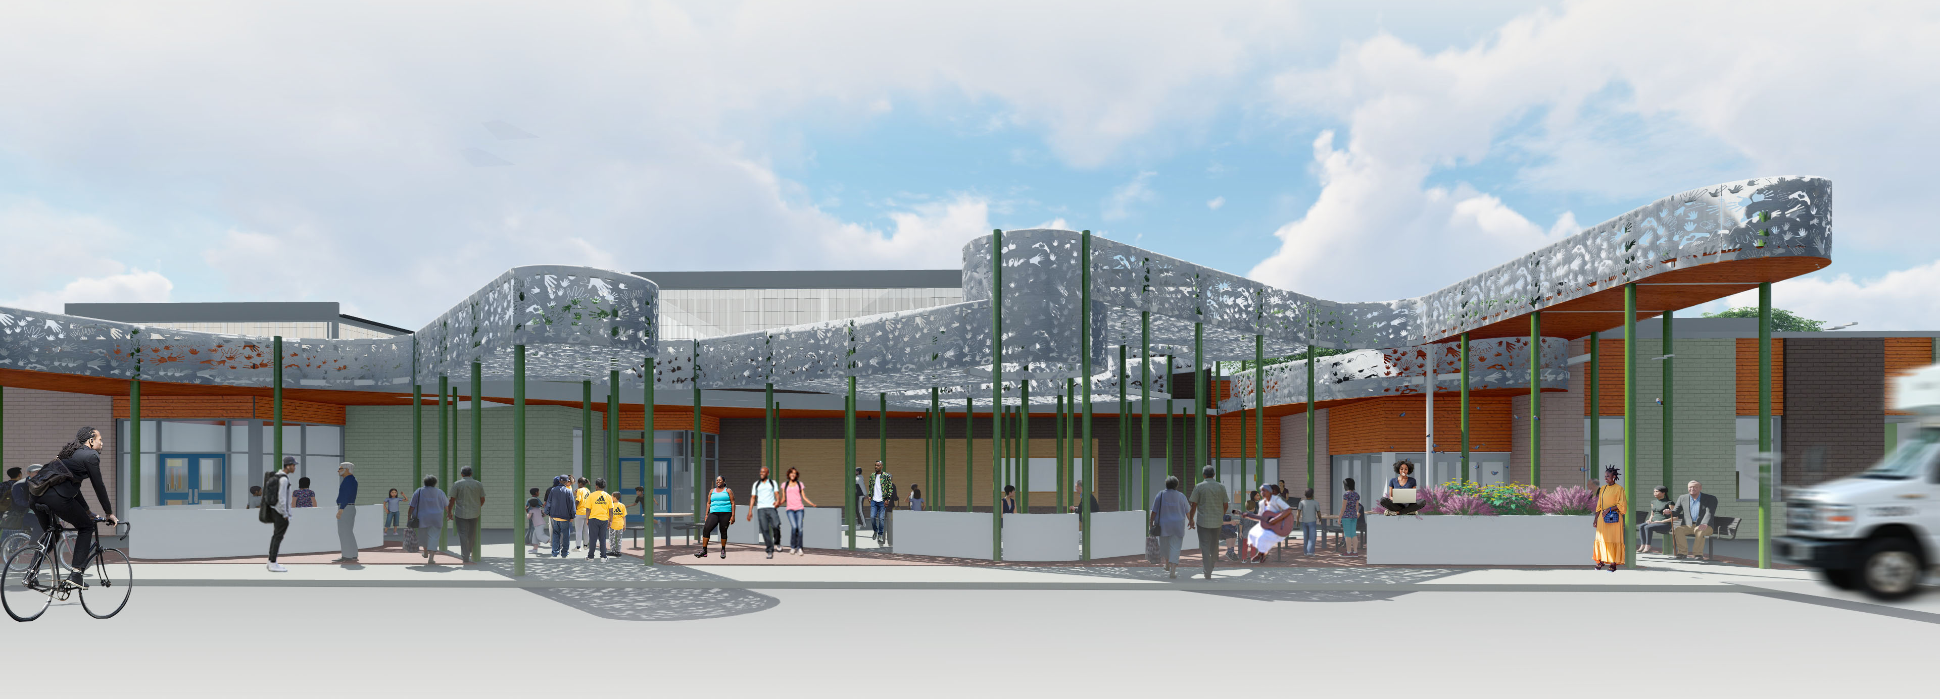
CONCEPTUAL RENDERING OF INTERGENERATIONAL PLAZA

Slide 4
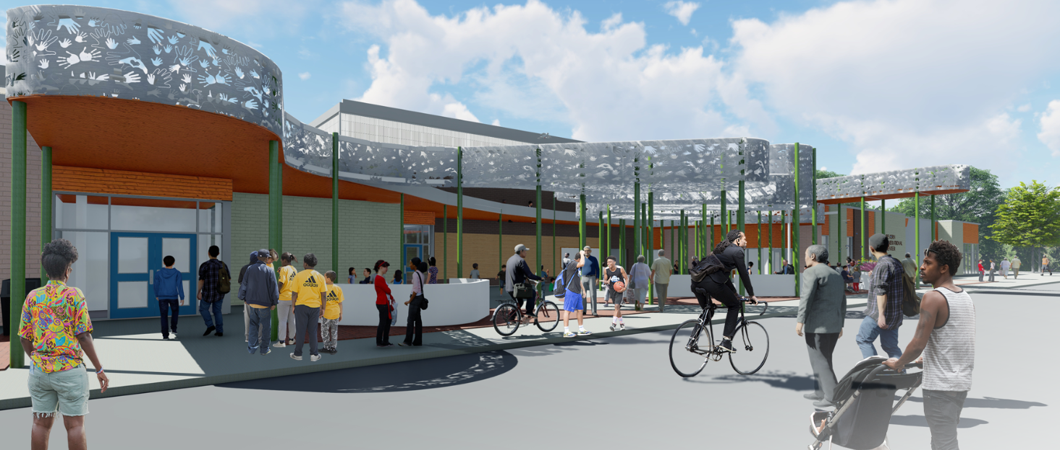
CONCEPTUAL RENDERING OF INTERGENERATIONAL PLAZA

Slide 5
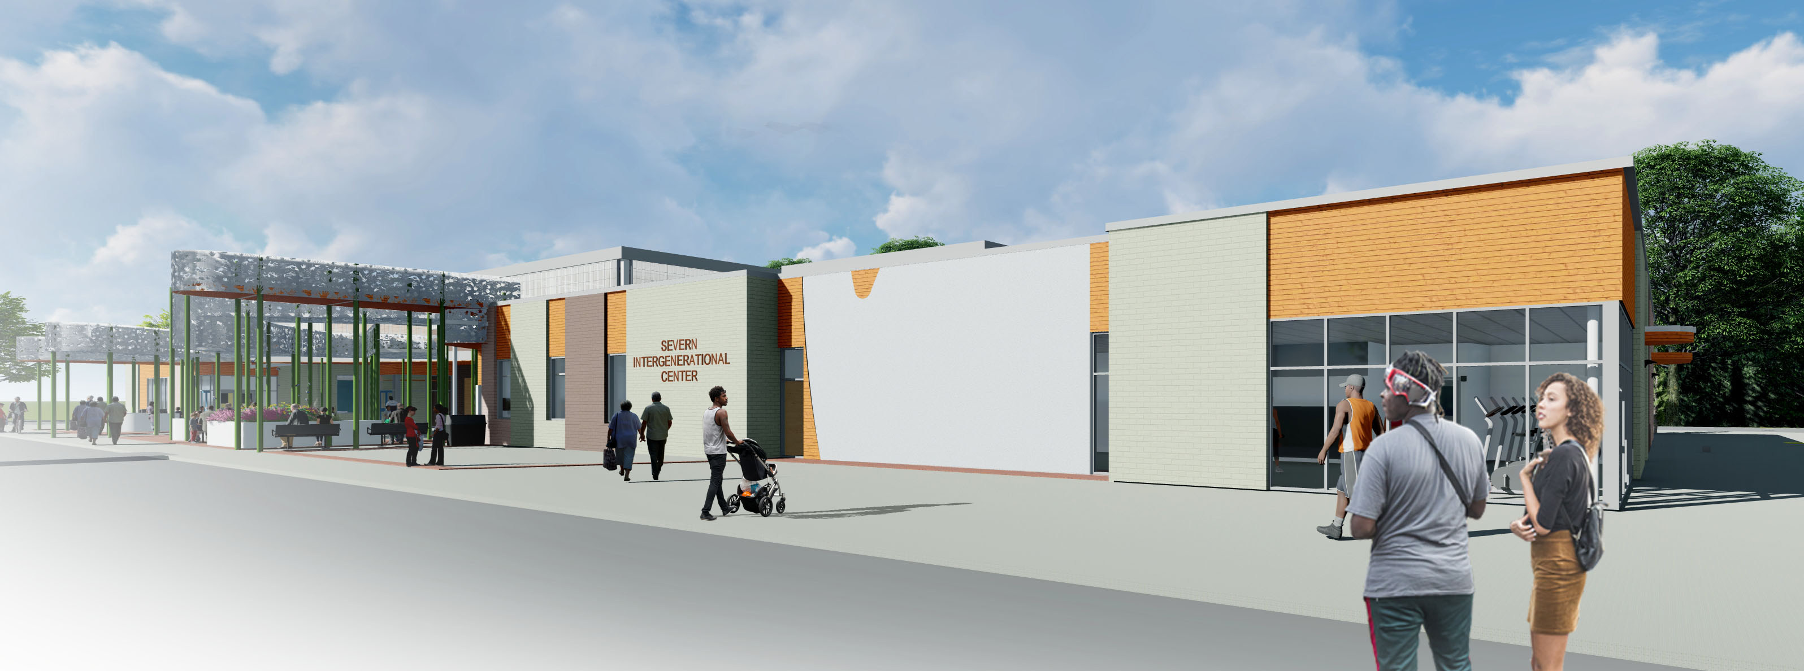
CONCEPTUAL RENDERING OF SENIOR CENTER & MURAL WALL

Slide 6
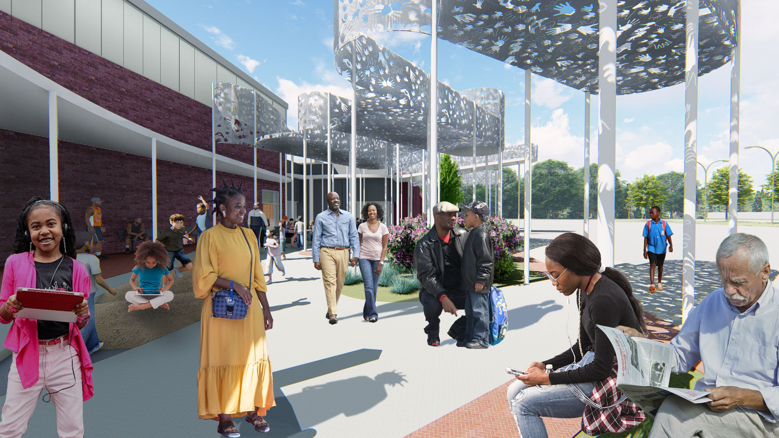
CONCEPTUAL RENDERING OF INTERGENERATIONAL PLAZA

